Slide 1

</>Developer Dashboard
Light, Scalable, pluggable, Open source analytics platform

Slide 2
Features
Light weight Analytics Dashboard
Trend anayltics / Ticket analysis /Project health anaylsis
Highly Configurable Architecture.
Easy integratetion with most of the ticket management system.
Works without Internet connectivity.
Project involving Users and Task can use this dashboard.
Needs minimum infrastructure (e.g. Raspberry Pi)
Can be used by upper level management.

Slide 3
Features
Exposed/Restricted Restful APIs
Lighning Fast Uses parallel-processing for optimised resource uses.
Built on open source tech/ tools.
Platform Independent.
Automatic Email trigger on Crtical errors.
Never required server access after deployment.
Log monitor / SQL execution / (Server/Process) Restart can be done from UI.
BUILT on LAMP stack (Perl)

Slide 4
Features
Admin access to restricted functionality.
User Management using CRUD API/UI
Only needs to upload CSV file from Upload section to update/populate data in Dashboard.
Capable of seding Daily DSR via email
Reports/Data export via Email as PDF.
Build to handle large data set.
FUSE ( Filesystem in User space) plugin has been developed to access tickets as a virtual Linux file system. All standard linux utility could be used for exploring tickets.

Slide 5



System Architecture
Upload
Data: CSV Upload
Report Processor
Dashboard

Slide 6
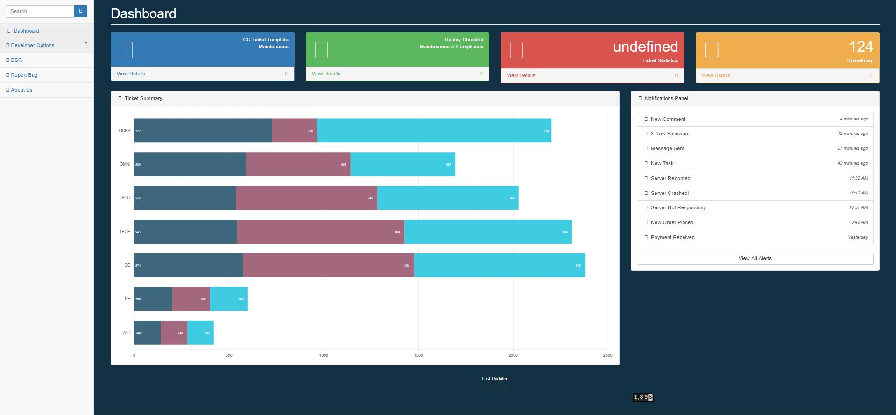
DASHBOARD

Slide 7
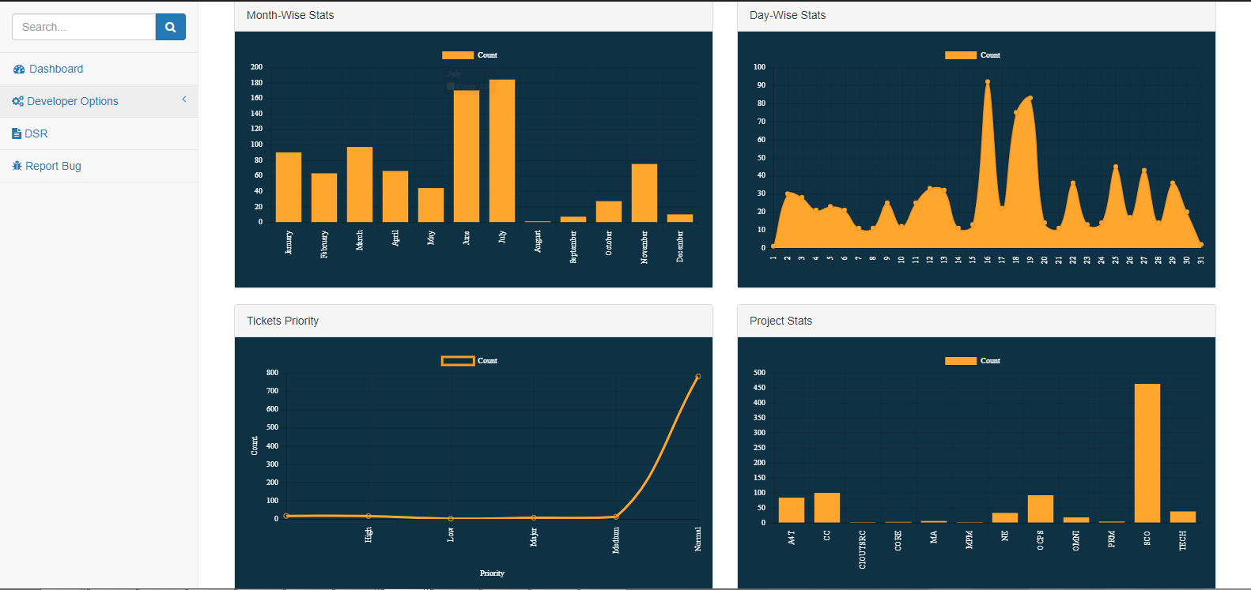
Trend Analytics

Slide 8
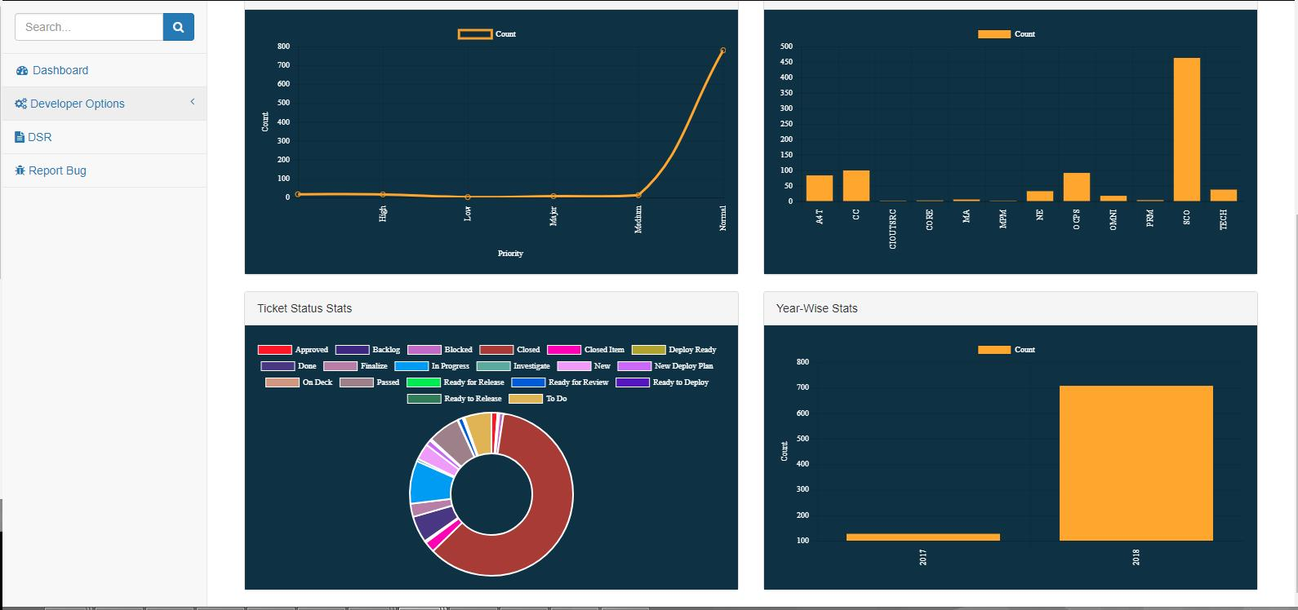
Trend Analytics

Slide 9
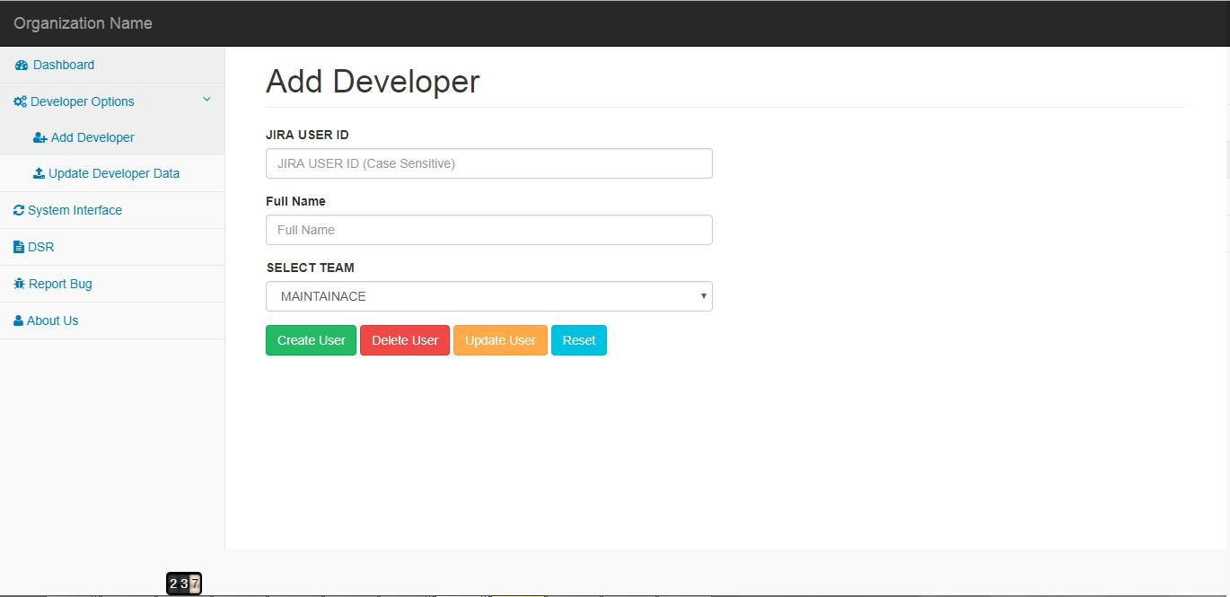
User Management

Slide 10
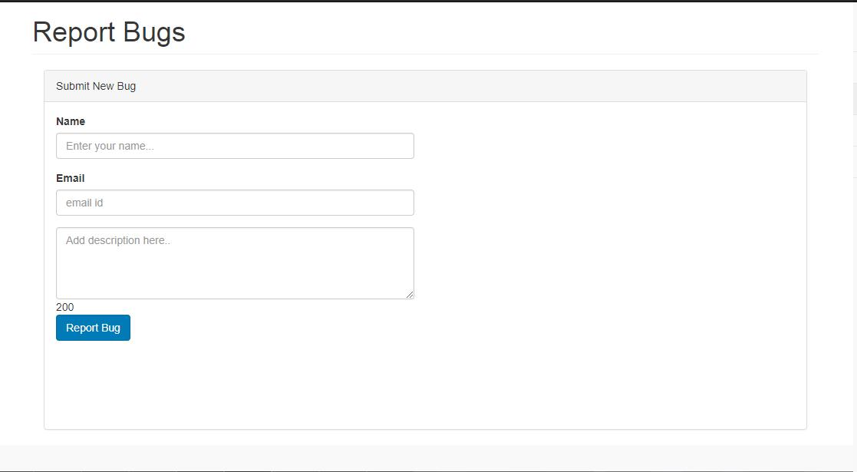
Bug Report

